Slide 1
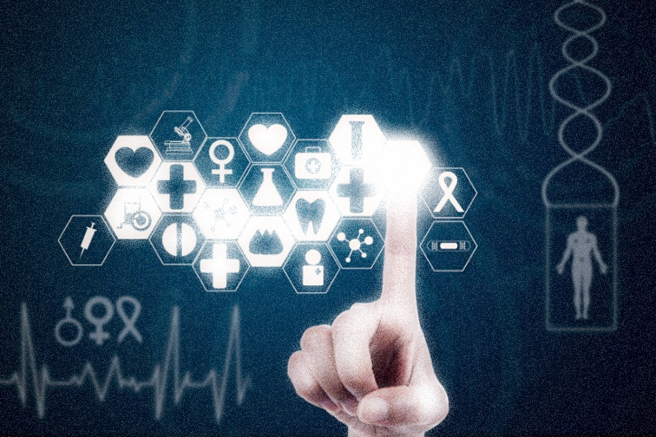
HealthCare Monitoring System
Using Smart Devices and IOT

Slide 2
PROBLEM STATEMENT
The cost of treatment provided by hospitals is increasing day by day.
People who lives in rural areas are finding it difficult to get basic medical facilities and there is lack of awareness as well.
Rural India is reluctant to approach hospitals and do not disclose their
illness until the last stage.
Sometimes doctors are not available in case of emergency.
There is a need for a self monitoring solution for people to identify and
if needed consult specialists as soon as they are diagnosed.

Slide 3
PROPOSED SOLUTION
Our solution involves developing an end-to-end healthcare monitoring system for both patients and doctors.
It helps eliminate the time taken to diagnose a particular illness and helps provide a quick feedback to a problem.
Periodic reports will help to track a patient’s progress and allow doctors to monitor them closely.
Smart IOT Devices are used to monitor the patient in better and efficient manner.

Slide 4
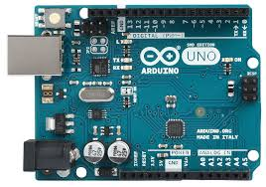

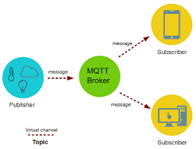
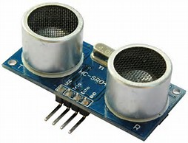


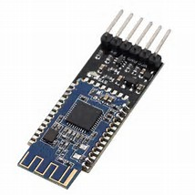
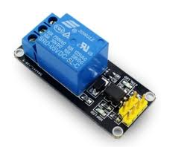

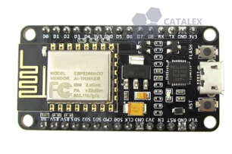

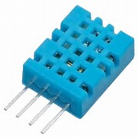

TECHNOLOGY/FRAMEWORK/HARDWARE

Slide 5
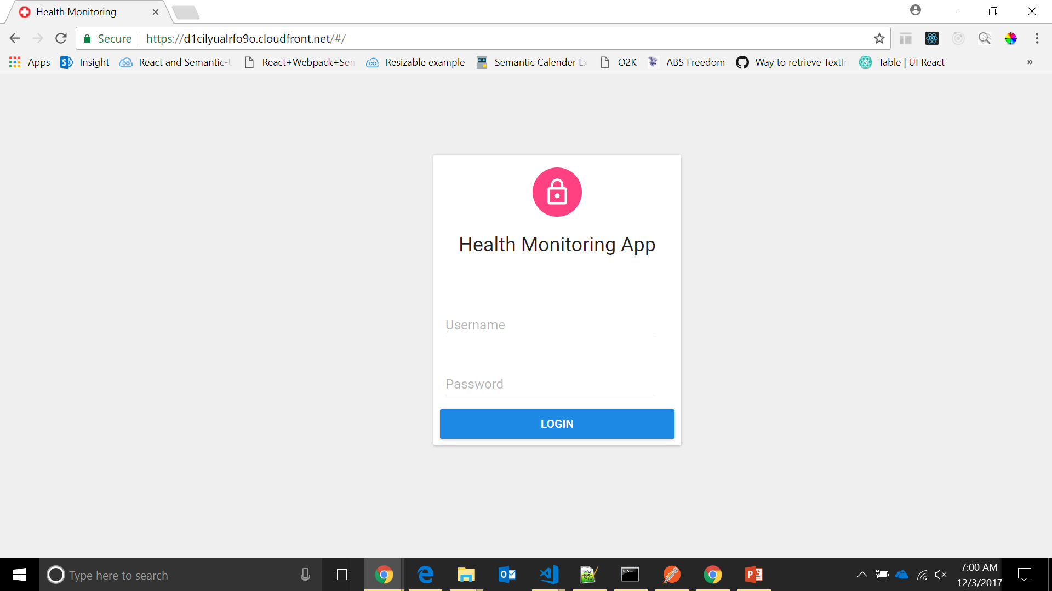

Slide 6
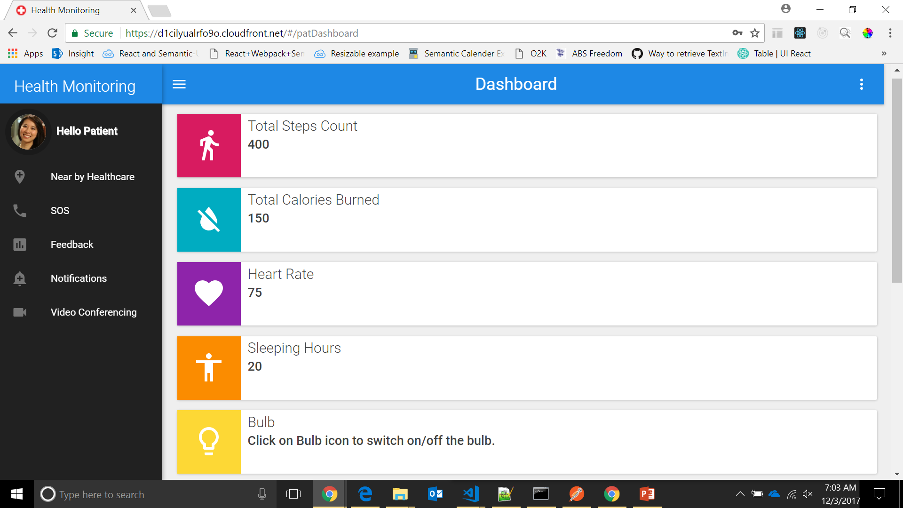

Slide 7
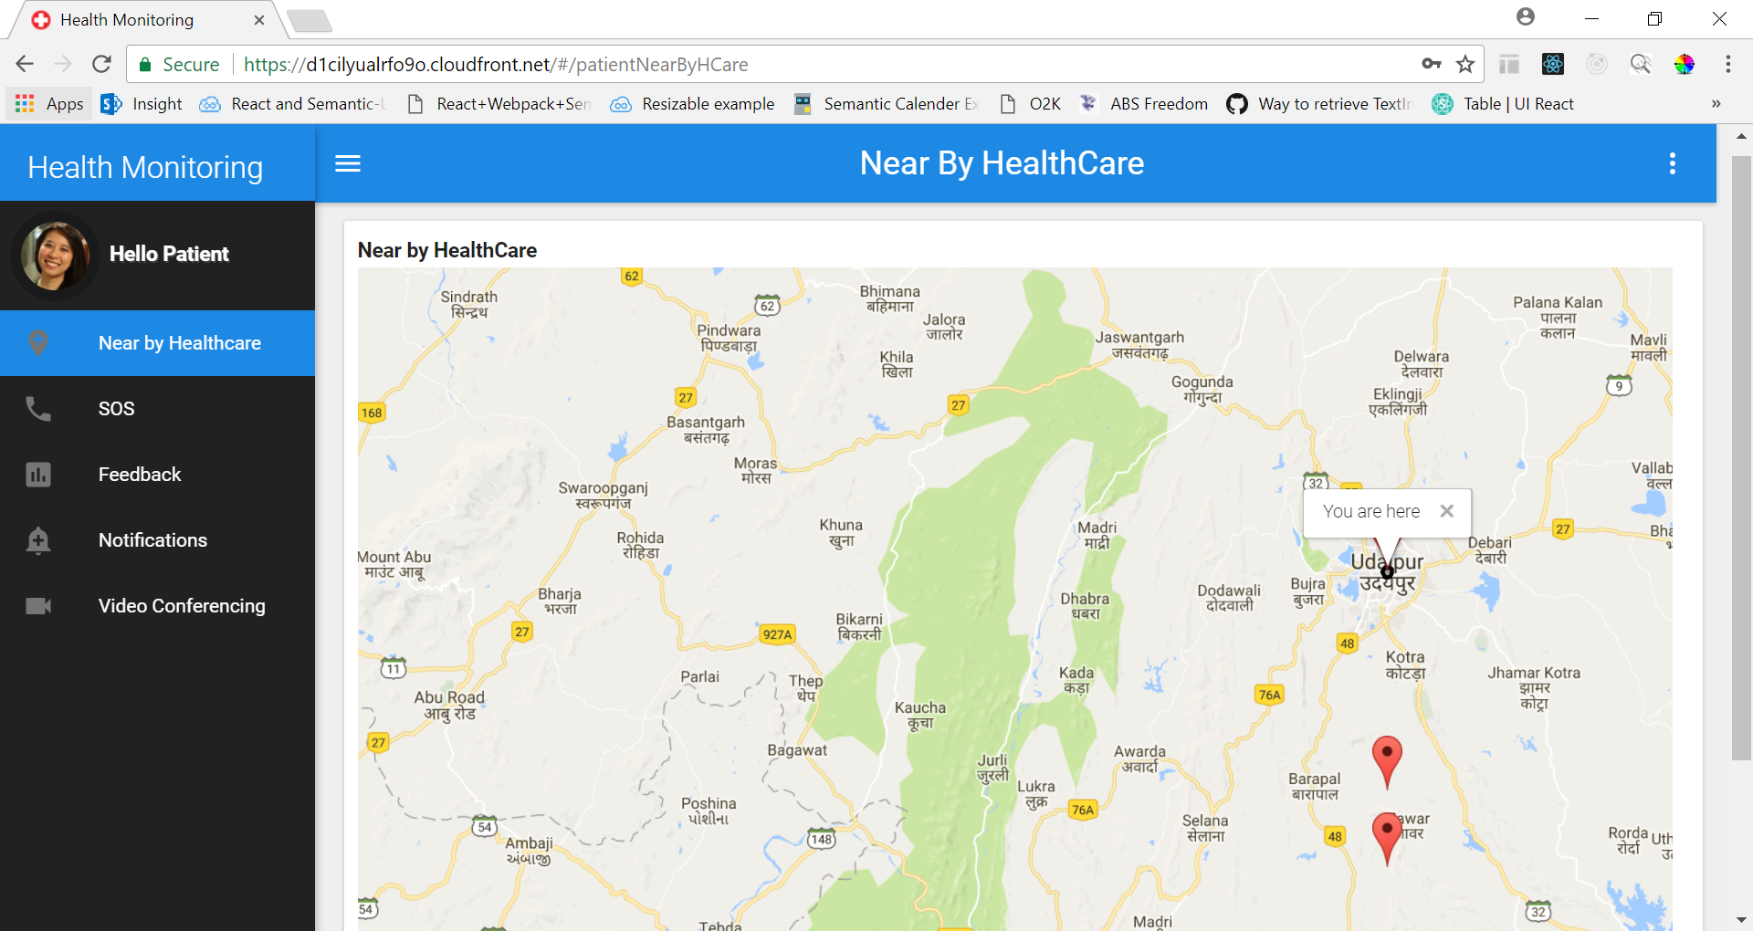

Slide 8
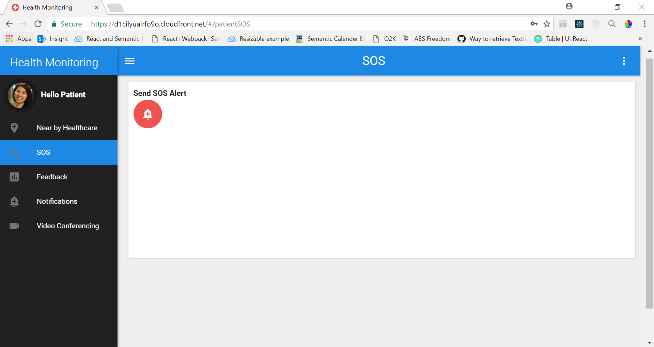

Slide 9
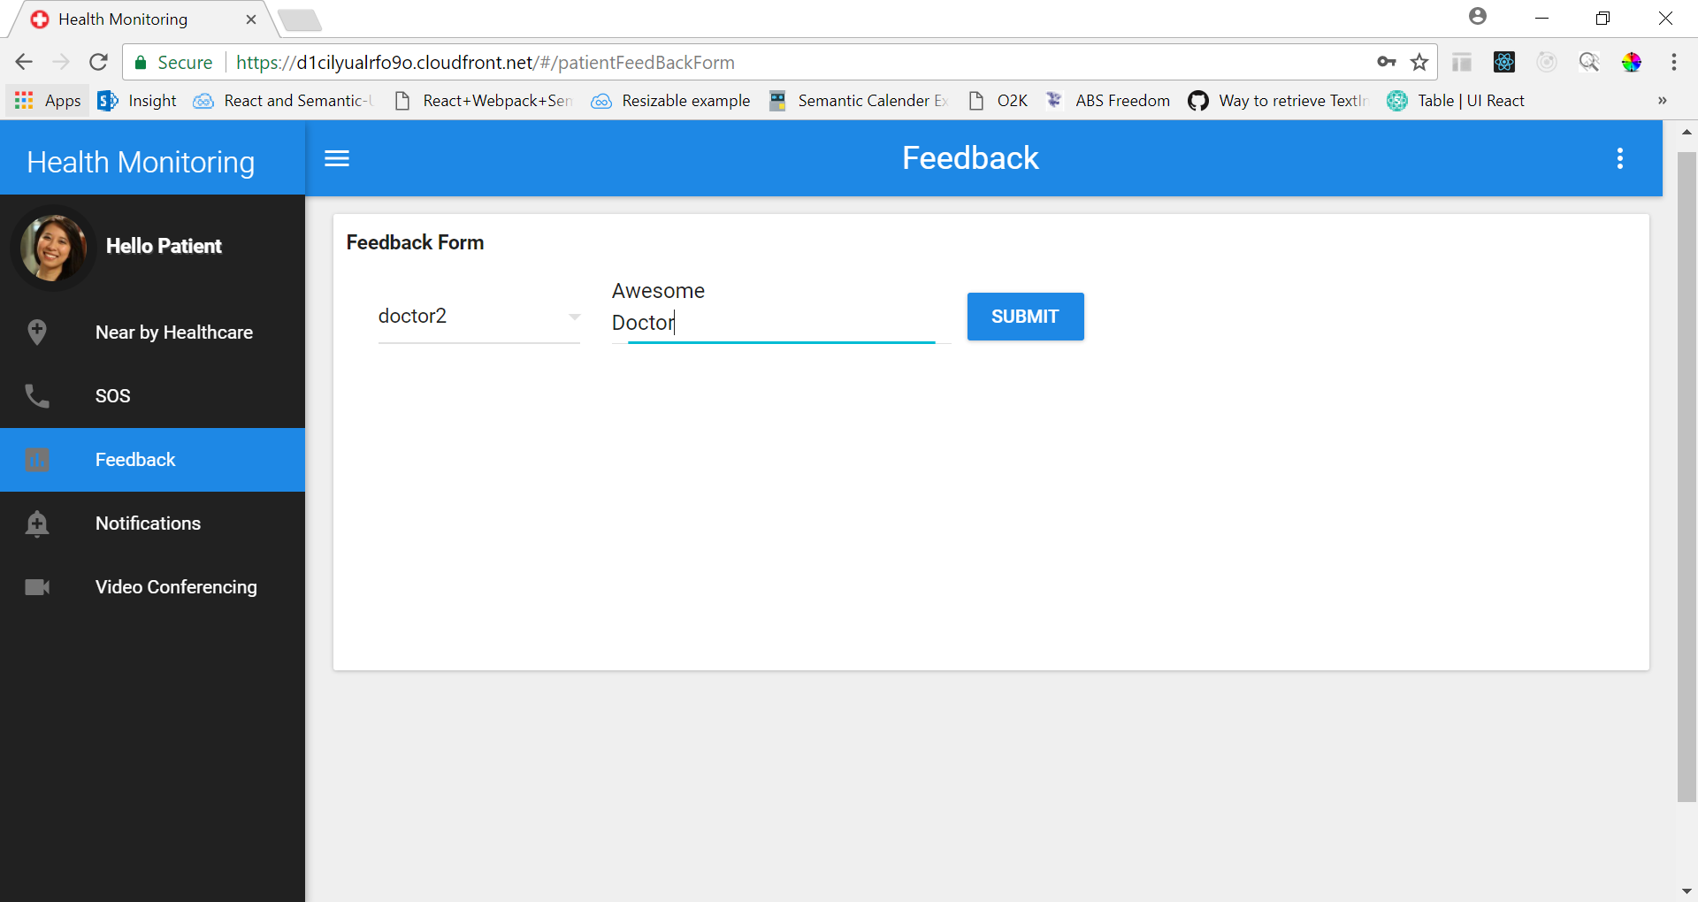

Slide 10
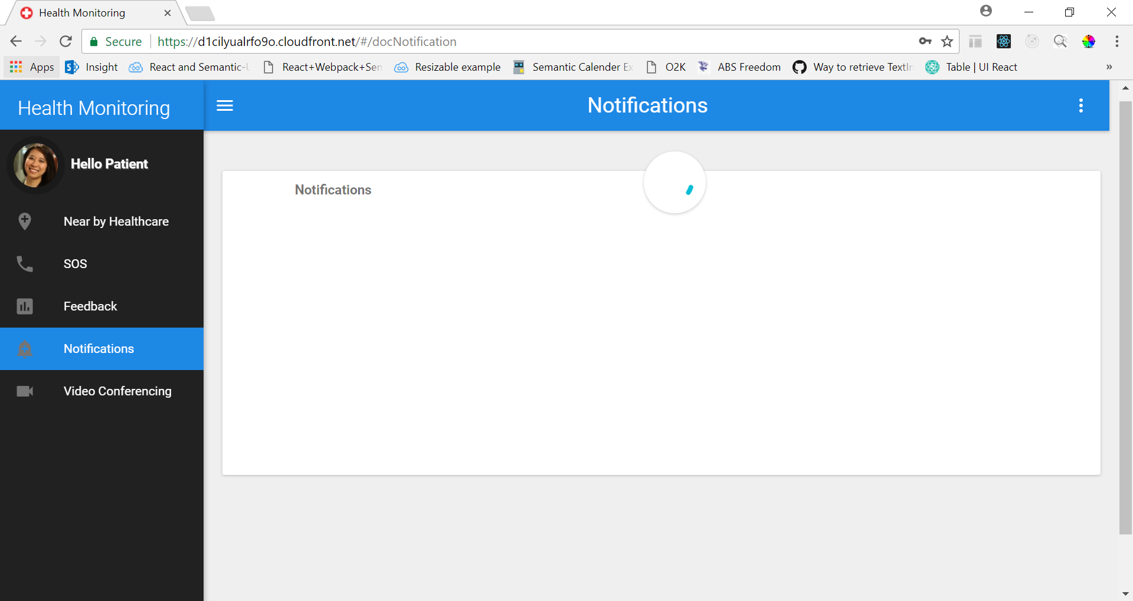

Slide 11


Slide 12
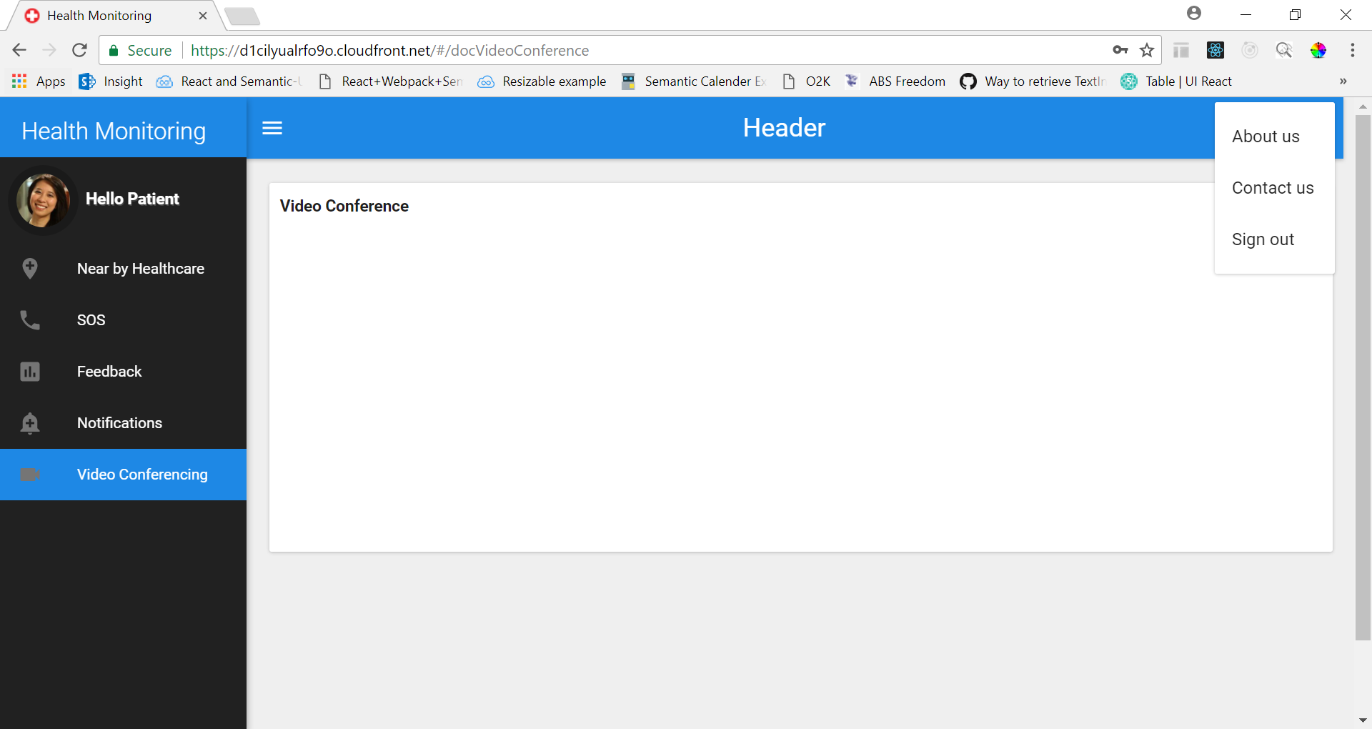

Slide 13
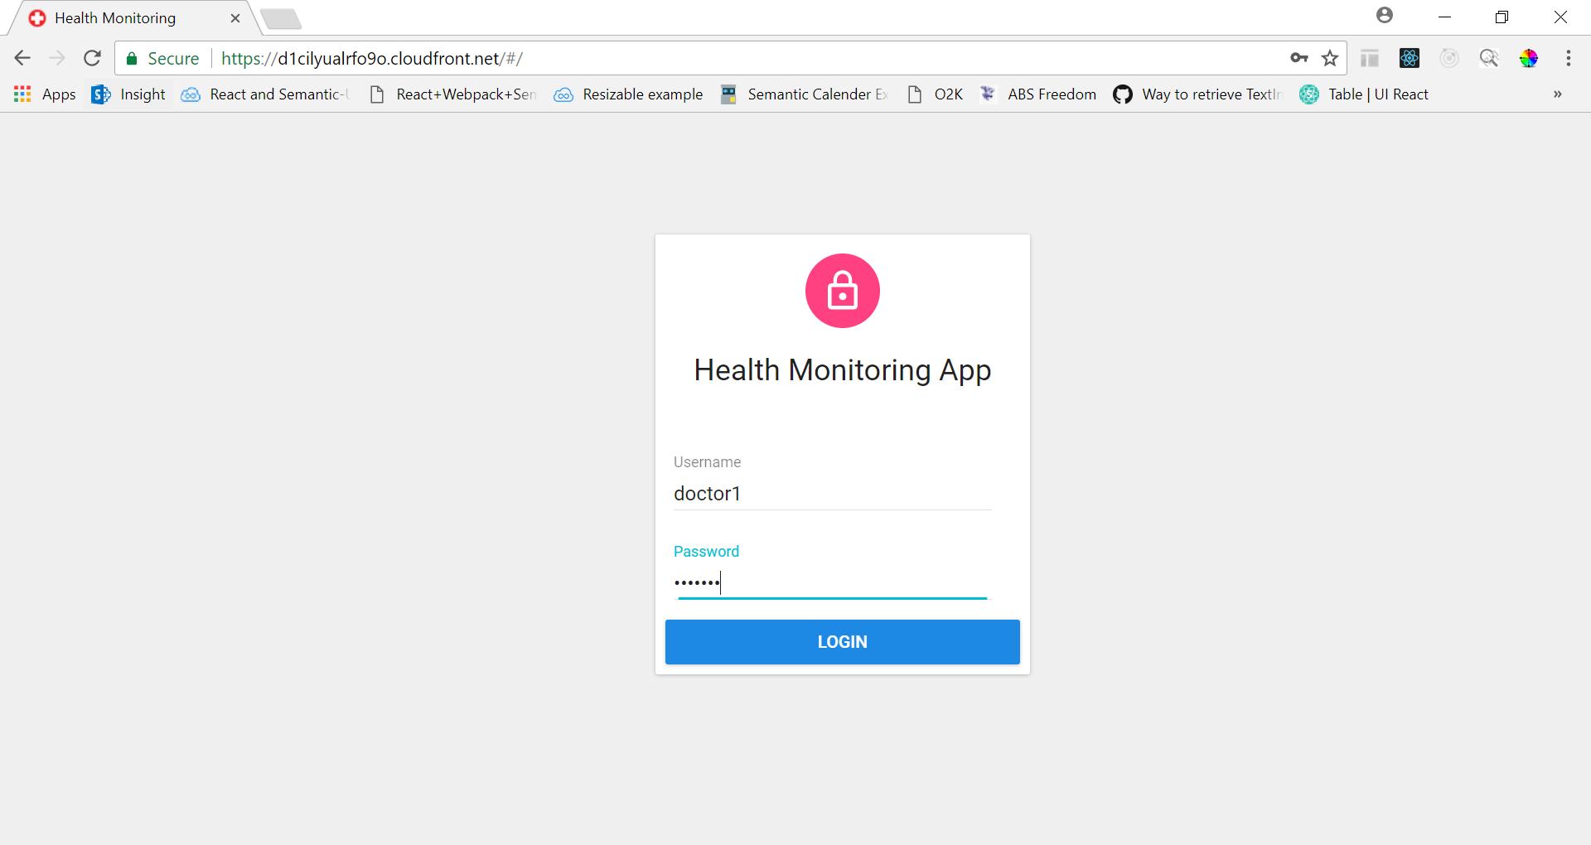

Slide 14
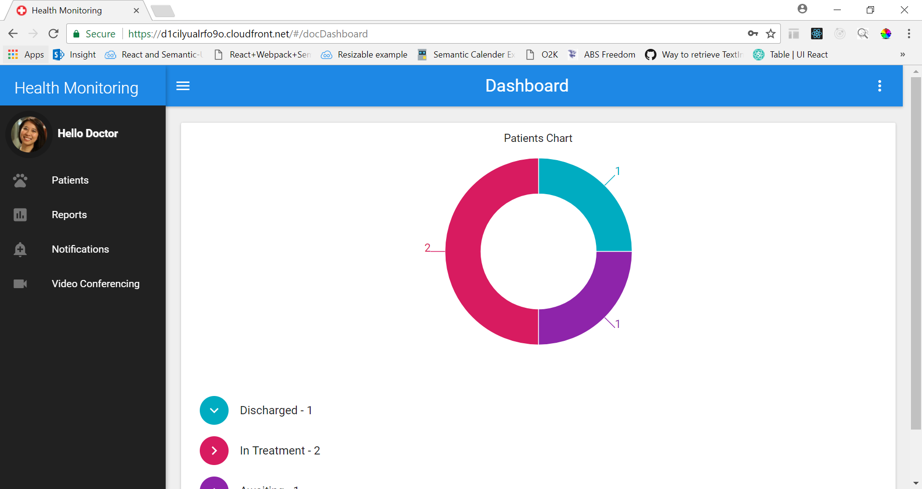

Slide 15
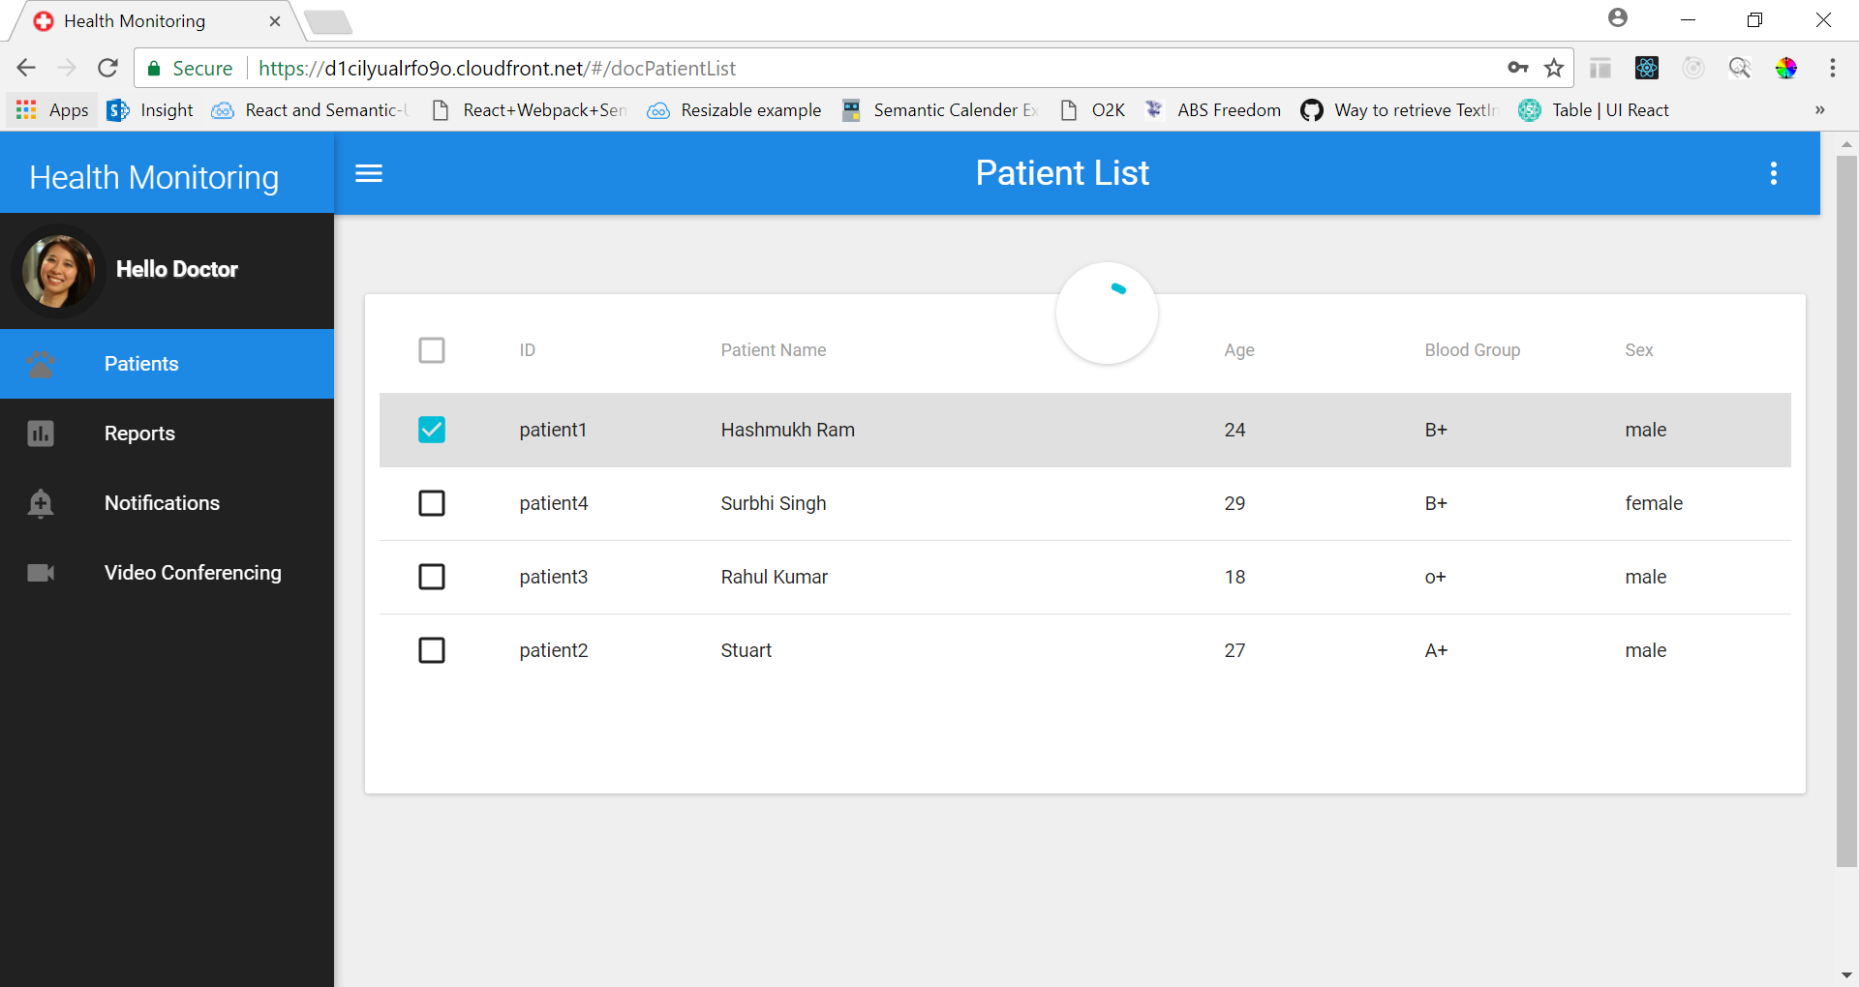

Slide 16
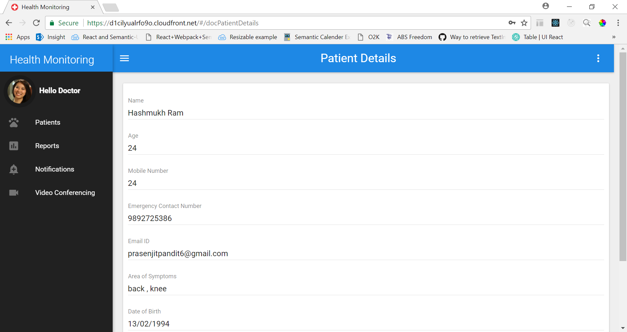

Slide 17
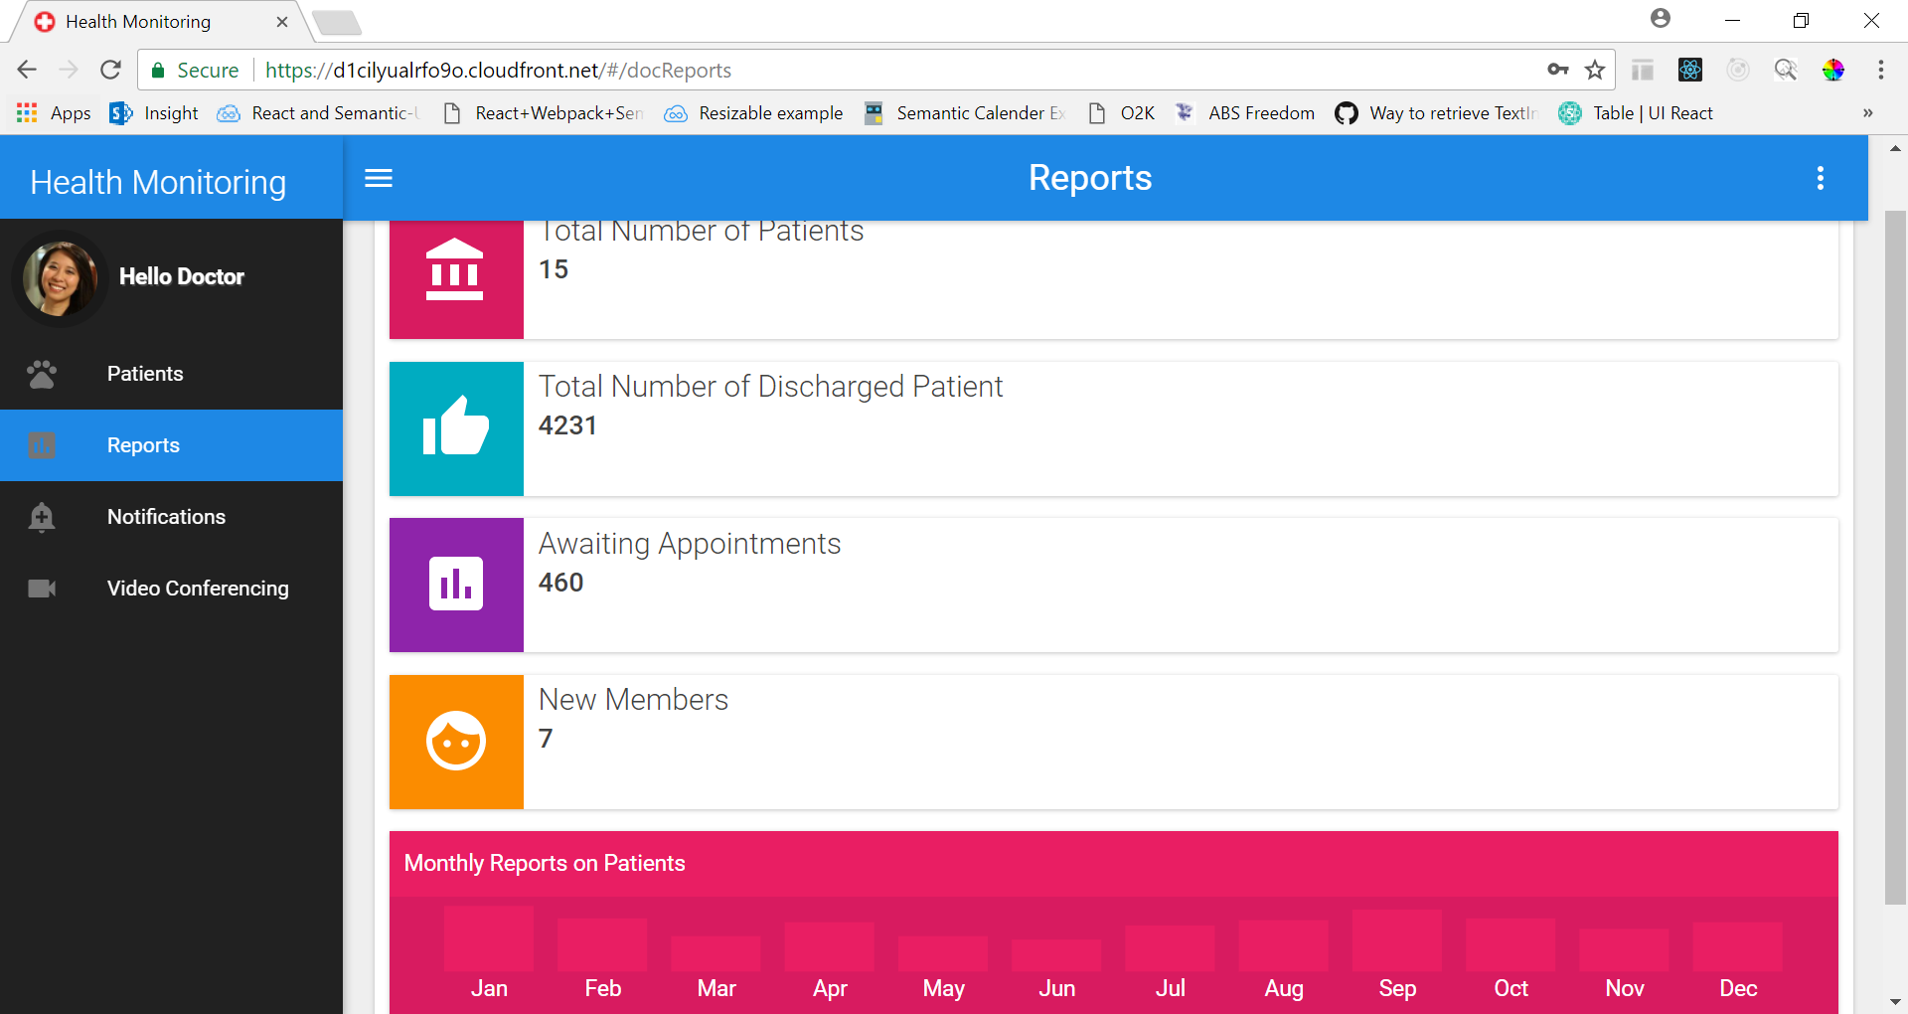

Slide 18
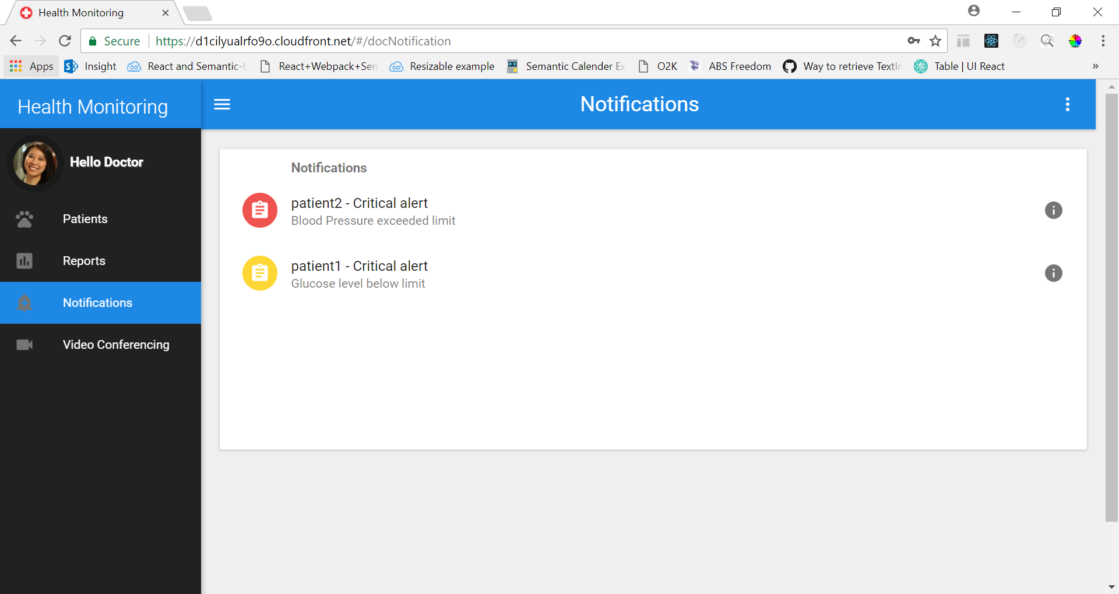

Slide 19
DASHBOARD SCREEN
Based on the user login, a customized dashboard will be displayed that provides a summary of the activities.

Slide 20
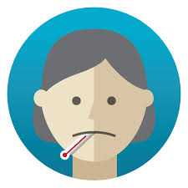
PATIENT DASHBOARD SCREEN
The patient dashboard screen will include features such as SOS, Google maps to locate nearby hospitals, consultation form, notifications/alerts

Slide 21
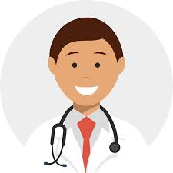
DOCTOR DASHBOARD SCREEN
The doctor dashboard screen will allow reports and prescriptions to be uploaded, selecting a particular patient assigned and monitoring his/her health statistics. Also, video conferencing can be done if required.

Slide 22
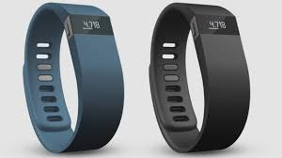
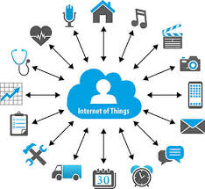
IoT IN HEALTHCARE
Through the use of sensors, patient health information will be monitored in
real time and provided to doctors through notifications. For example, if a blood pressure of a patient goes above normal, an alert will be immediately be sent to the assigned doctor.

Slide 23
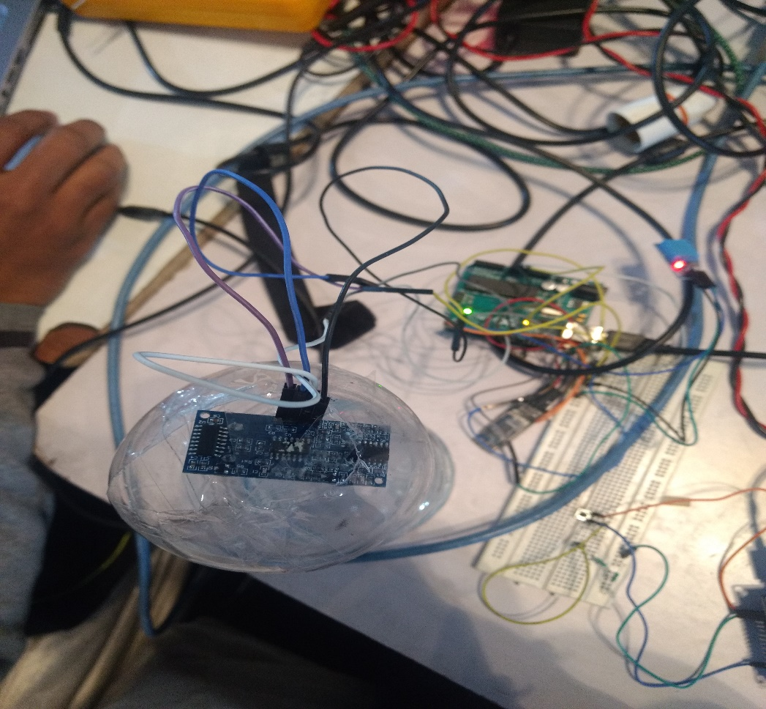
Ultrasonic sensor is used to measure Saline level or glucose level which trigger the alert in case it going to end. Otherwise it may to lead reverse flow of blood.

Slide 24
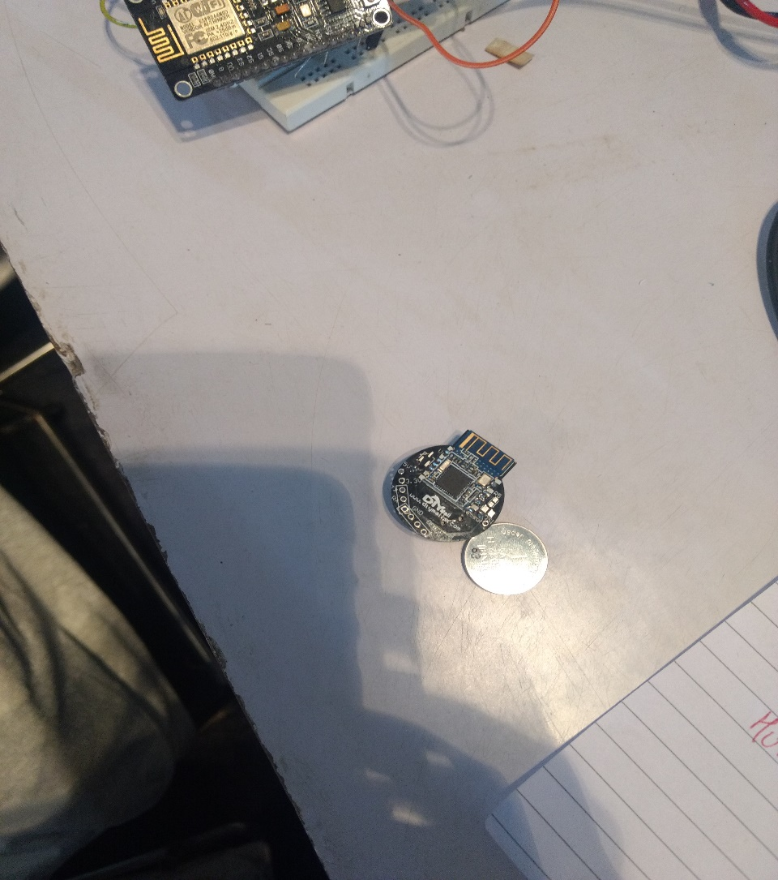
Beacon is used to track Asthma pump in case it get lost

Slide 25
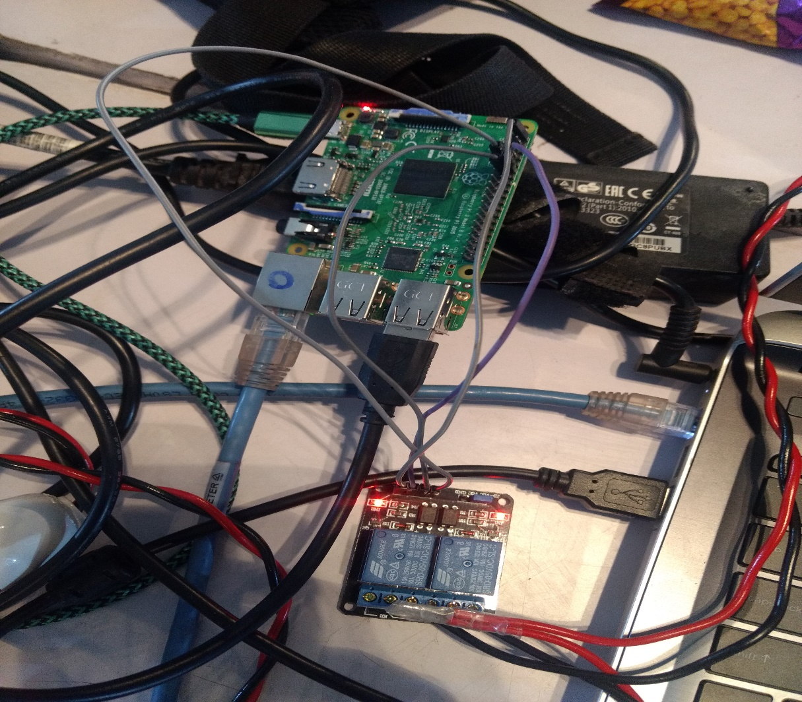
For patient who is paralysed or not able to move can control any appliances wirelessly through Wifi like bulb,Fan etc

Slide 26
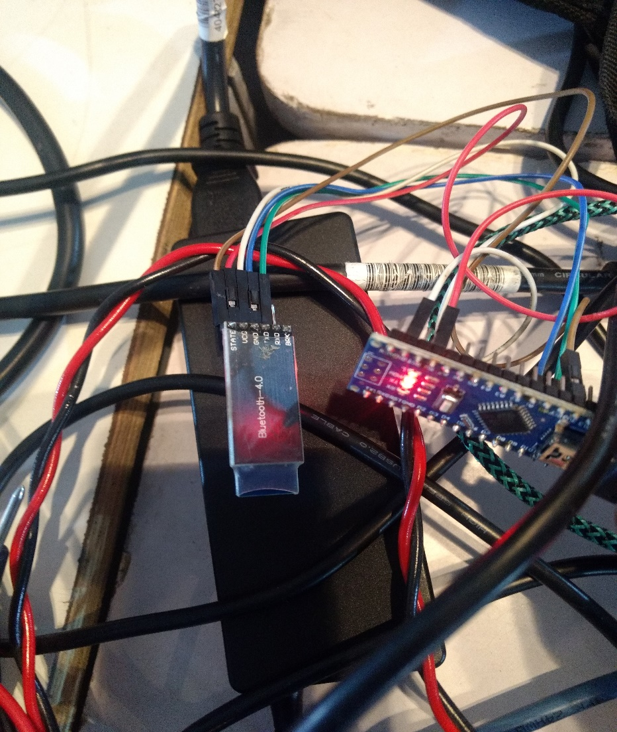
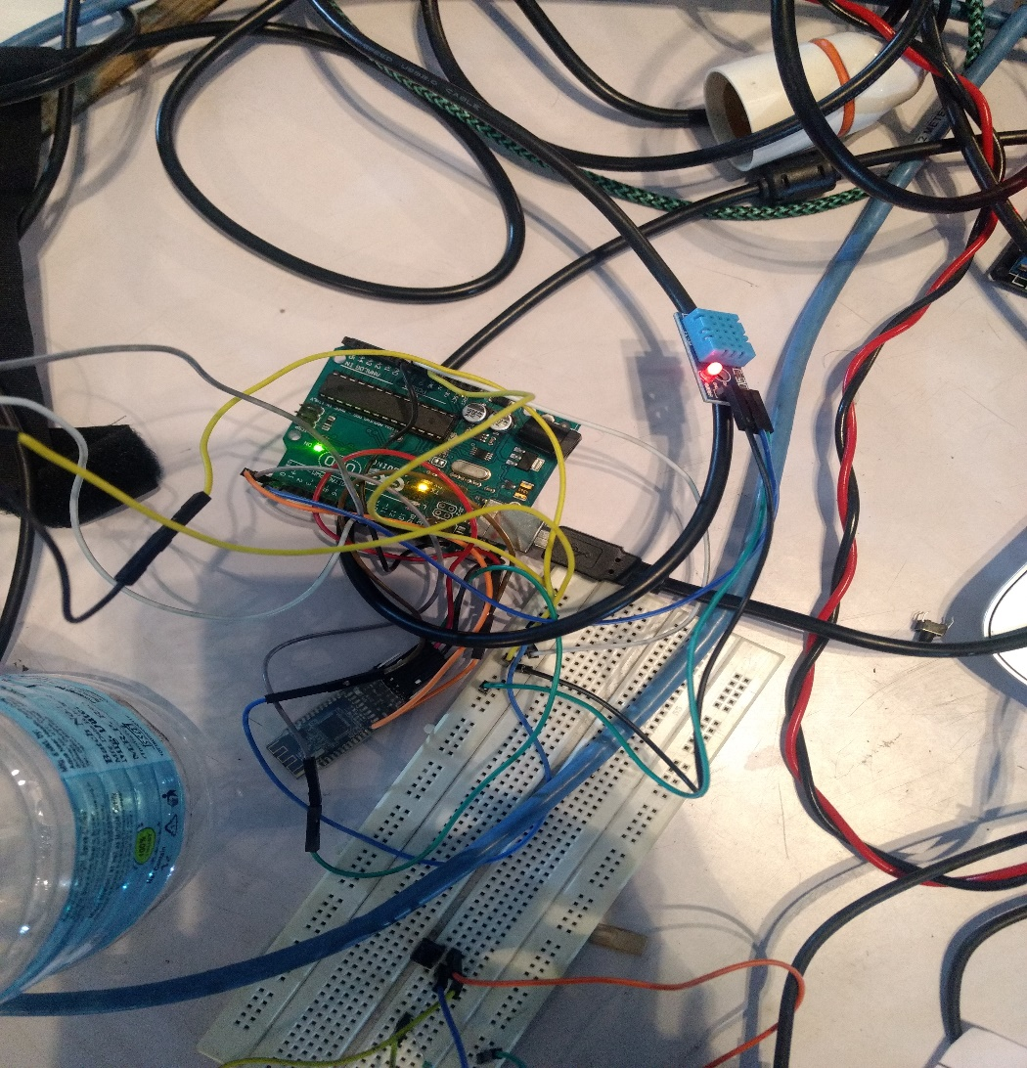
Wireless Bluetooth to Bluetooth communication from node side (Arduino with sensor) to Gateway(Raspberry pi)

Slide 27
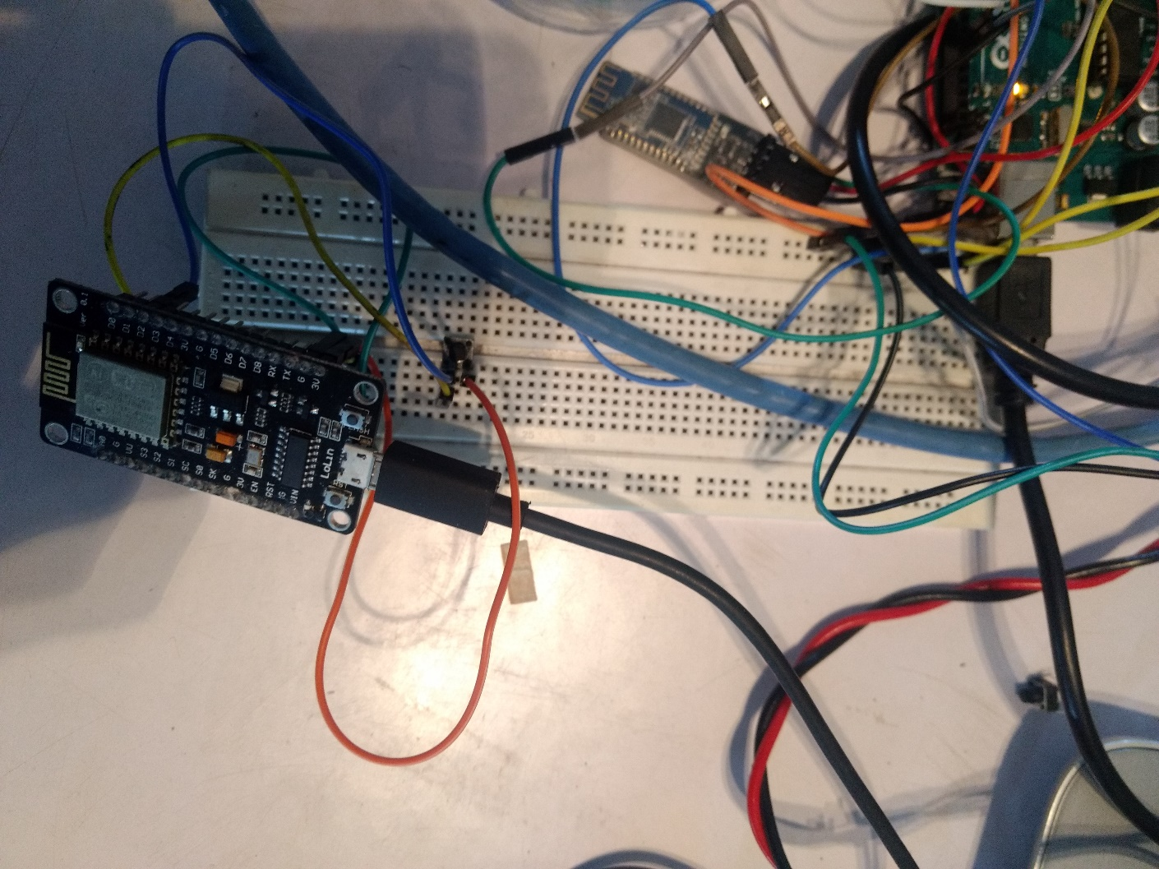
Panic button with wifi chip in case any patient get heart-attack(or in case of emergency) can push the button to send Email Alert to Relatives

Slide 28
CONCLUSION
Healthcare monitoring system aims to provide health related
Information on the go. It allows medical staff and professionals to collect, analyze and track data efficiently.

